Slide 1
Technology, Remote Learning, and Play
© 2023 President and Fellows of Harvard College. This work is licensed under Creative Commons Attribution-NonCommercial-ShareAlike 4.0 International. Funded by the LEGO Foundation, this resource was developed by Pedagogy of Play at Project Zero.

Slide 2
Gameplan:
Understand ways tech can be beneficial v. harmful and then be able to bring a critical mind to planning/evaluating learning experiences
Consider qualities of meaningful and playful remote-learning experiences

Slide 3
Agenda
Add yours here

Slide 4
Notes:
Playful start – playing with Scratch or Scratch Jr. (this image is from Scratch Jr, for younger children)

Slide 5
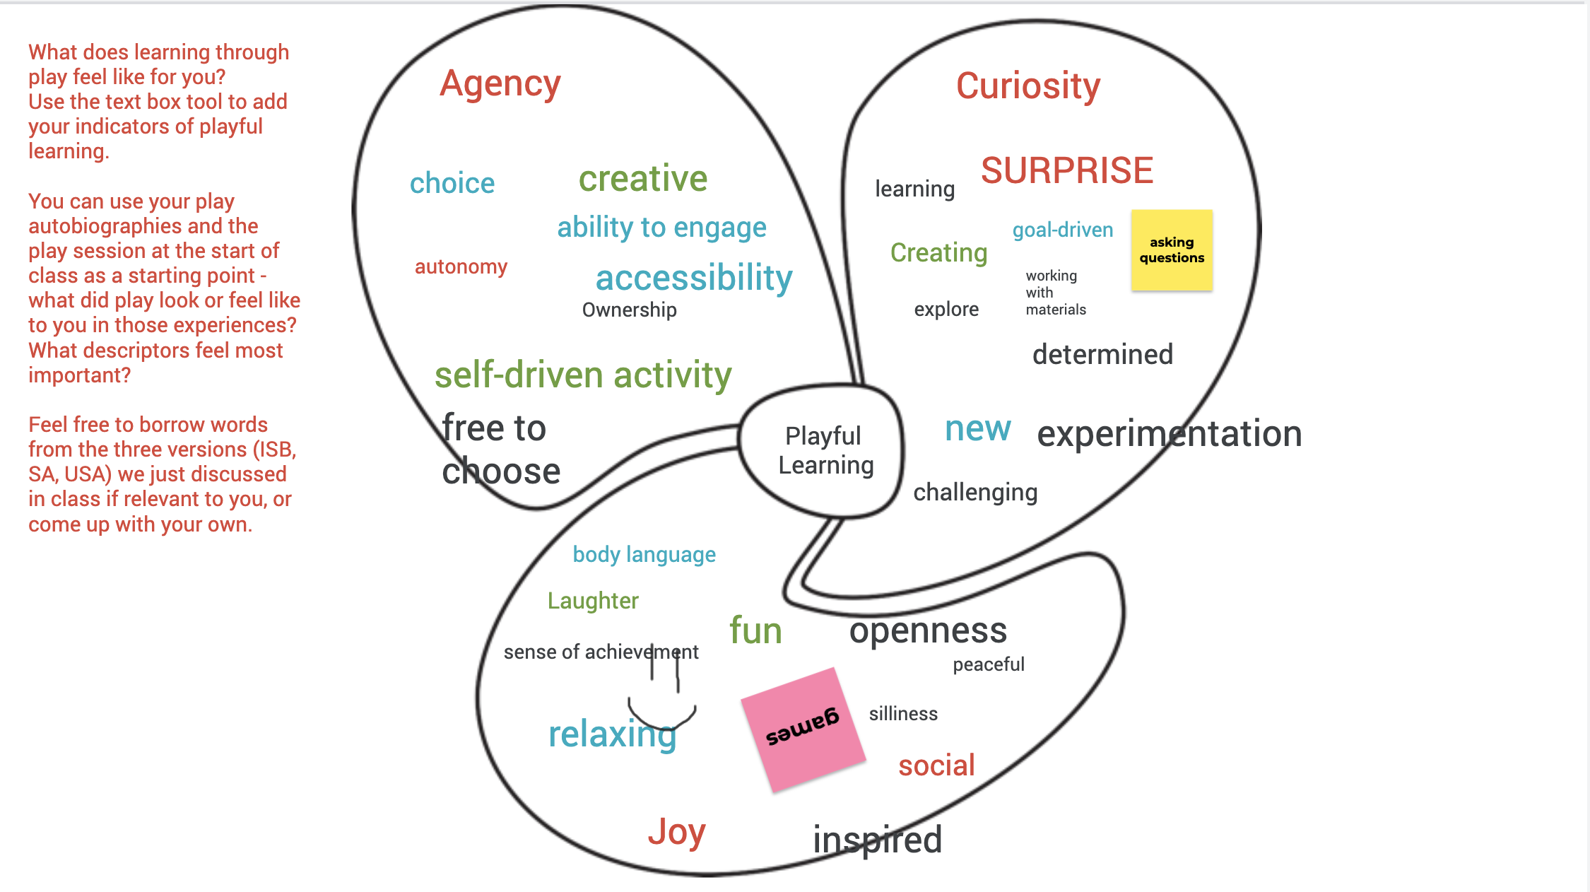
Debrief: What did you experience using Scratch?
Note: These are the indicators that one class created together. Insert your class indicators (or the ones developed by PoP that are most appropriate for your context) here. Use these to discuss/debrief the play activity you just engaged in.

Slide 6
American Academy of Pediatrics 2019 media recommendations for families:
Age 2 and under: avoid media use (except video chatting).
Preschoolers: No more than one hour of high-quality programming per day.
Grade-schoolers/Teens: Don’t let media displace other important activities such as quality sleep, regular exercise, family meals, “unplugged” downtime.
All ages: Be a media mentor. Co-view media with your kids. Help children understand what they are seeing, and help them apply what they learn to the world around them.
Do not feel pressured to introduce technology early; interfaces are so intuitive that children will figure them out quickly once they start using them at home or in school.

Slide 7
More AAP recommendations for families:
Avoid fast-paced programs (young children do not understand them as well), apps with lots of distracting content, and any violent content.
Turn off televisions and other devices when not in use.
Avoid using media as the only way to calm your child.
Monitor children’s media content and what apps are used or downloaded. Test apps before the child uses them, play together, and ask the child what he or she thinks about the app.
Keep bedrooms, mealtimes, and parent–child playtimes screen free for children and parents. Parents can set a “do not disturb” option on their phones during these times.
No screens 1 hour before bedtime, and remove devices from bedrooms
Notes:
Documentation is different…

Slide 8
Mitch Resnik on play and technology
Click on the icon to the left to hear Mitch Resnik (one of the creators of Scratch) talk about play in the physical world v. the digital world.

Slide 9
“I never thought of that before!” A playful learning routine for sharing and discussing new ideas
Go to (insert link to a Jamboard, Padlet, etc – or use physical materials to post ideas in your classroom)
Post an idea/practice/activity that interested you in the popatplay blog post you read for class today on remote learning
Read over your colleagues’ posts and mark two that interest you by adding a colored dot or check mark next to that post
We will discuss the posts with the most votes in a few minutes!

Slide 10
Principles for Balancing Online/Remote and In-Person Learning for Young Children
15/45 Minute Rule: Give your full attention to young children for 15 minutes and then put an activity out or an online lesson/video so that you can work or complete other responsibilities for 45 minutes.
5 Senses: Children learn by touching, listening, talking, moving around, observing and tasting. When things are bleak, go outside for a short walk and see what children notice and let them use all their senses. Or let children explore materials in the house like rocks, leaves, sea shells, instruments or cooking utensils.
Balance online with in-person learning: Children learn through their bodies. Online learning (listening to people read books, math facts, reading apps, etc.) should be evenly balanced with in-person/hands-on activities like building, working, drawing or playing.
Pass on Your Knowledge: Children want to learn about what parents are excited about. Teach your child to appreciate what you are interested in by letting them participate with you.
Learning happens by trial and error: Teaching children is challenging and scary at times. We don’t have to be experts to show love, attention and provide learning opportunities to young children. Young children learn to walk by falling down and so do their parents and caretakers.
http://sites.edb.utexas.edu/agency-and-young-children/

Slide 11
From: https://www.legofoundation.com/en/learn-how/knowledge-base/distance-learning-guide/

Slide 13
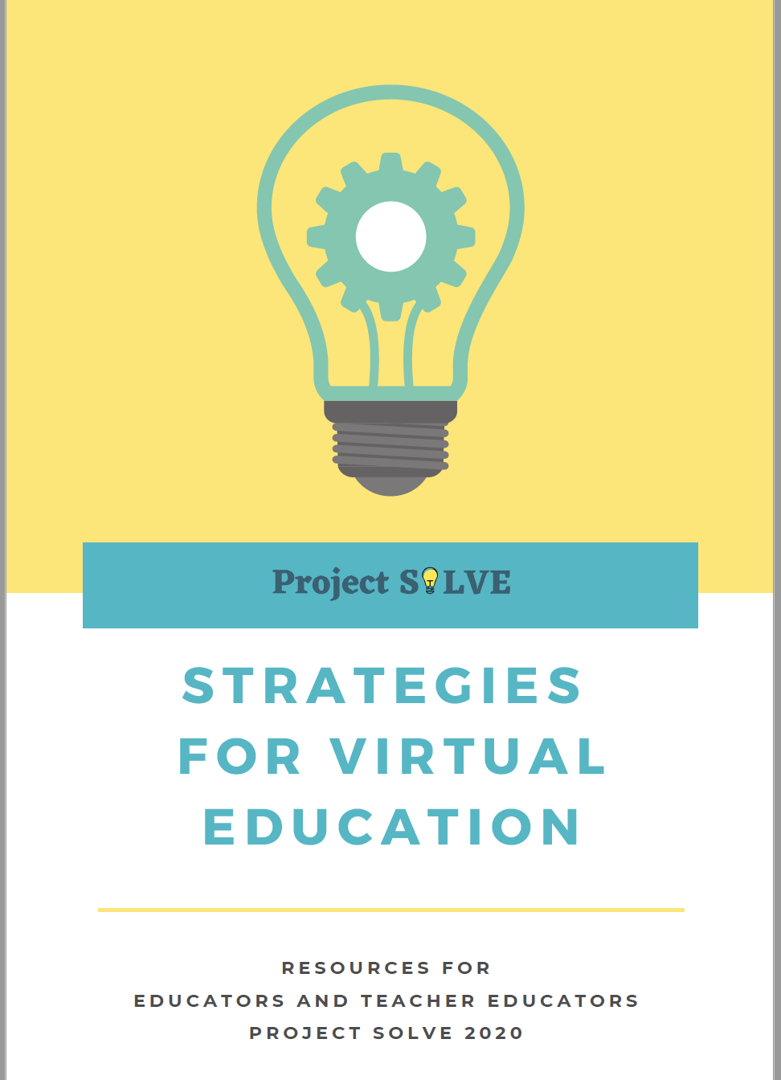
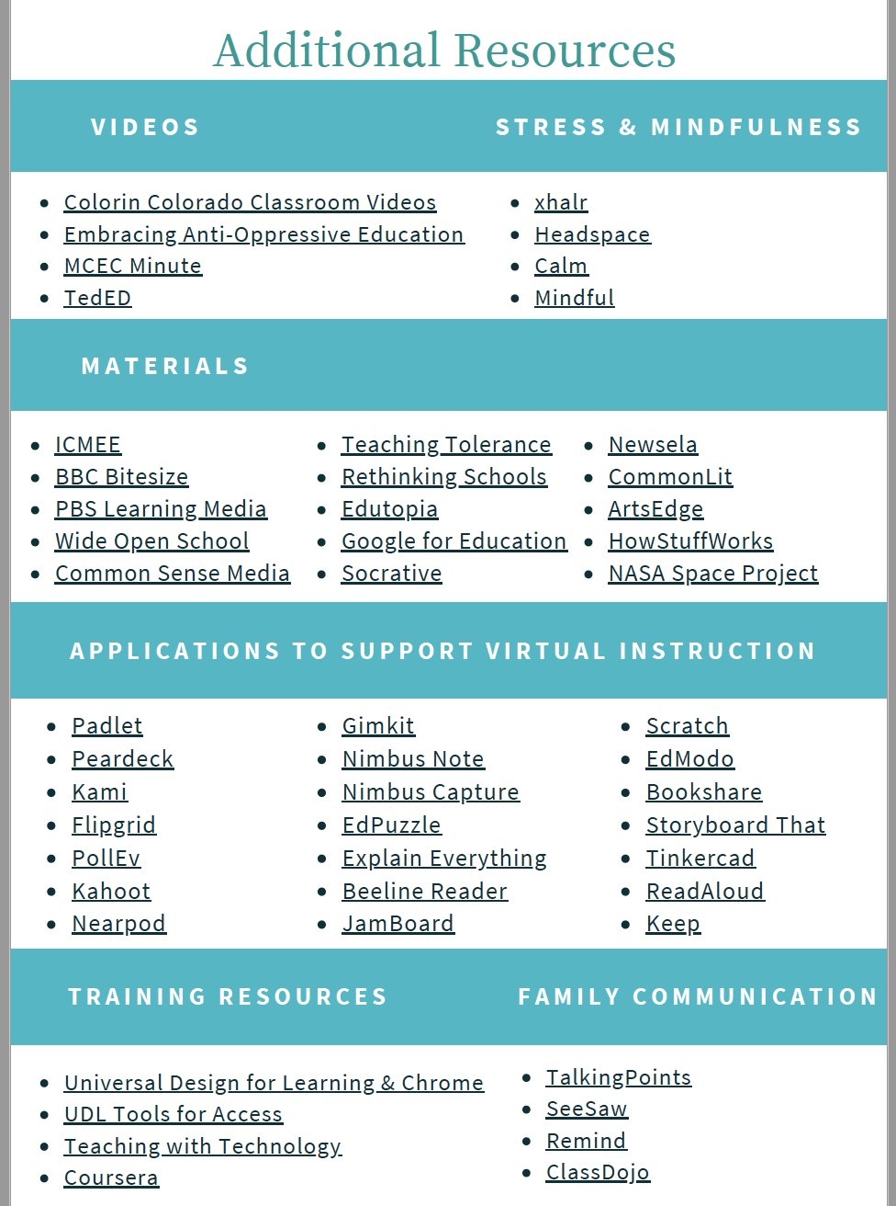
From the Project Solve guide – downloadable at https://drive.google.com/file/d/1Jg5sK1LgDh1_k-gGasa9ZnfYrurR7Lt_/view

Slide 14
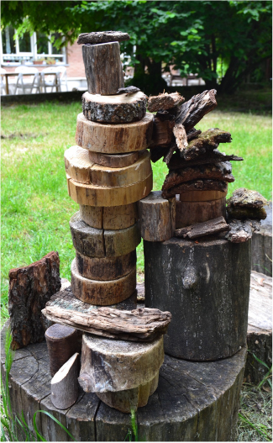
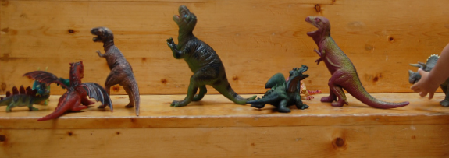
Math Games
Using materials in your play kit or nearby, design a math game that you and your partner can play remotely.
Your game should engage learners in exploring a foundational math concept (e.g. counting, comparing, grouping…)

Slide 15
Playful Learning at a Distance: Additional Provocation
Walnuts
https://www.reggiochildren.it/en/athomewiththereggioapproach/a-walnut/

Slide 16
Note: These are the indicators that one class created together. Insert your class indicators (or the ones developed by PoP that are most appropriate for your context) here. Use these to discuss/debrief the play activity you just engaged in.

Slide 17
I used to think… Now I think…
Notes:
Discussion prompt: Now you’ve read different statements about managing/limiting screen time, heard the research brief, done some technology play yourselves this evening, and heard from Mitch about his perspective. How is your thinking changing based on these experiences/perspectives? Take a minute and jot down.. “I used to think, now I think” and then we’ll share and open up for a discussion. Remember that this can also be a place to name a question that you are still grappling with –e.g. “now I think… but I’m still not sure… does x cause y?”

